Slide 1
JMS 1.1
Message – exchange the data between software to software among networked computers through Destination( Queue/topic)
In 1999 JMS first 1.0.2 version released.
Major changes in JMS 1.1 is, both topic and queue unified API and both can share same transactional unit of work.

Slide 2
Heterogeneous platform communication
Asynchronous communication
Scalability ( big application have more module and need integration among modules )
The use of JMS is mainly to solve
Reliability
Asynchronous communication
Heterogeneous integration

Slide 3
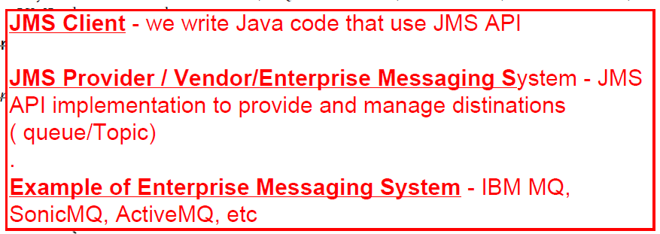

Message has
Business Data
Network Routing header

Slide 4
External JMS Providers
Internal JMS Providers
IBM Websphere MQ ( MQSeries)
IBM Websphere app server
Sonic MQ
Weblogic ,Jboss app servers
ActiveMQ
As a developer, I write only JMS client
MicroSoftMQ
Tibco Rendevouz
To achieve heterogeneous some message provider use Bridge, to convert JMS message to .Net/ anyother

Slide 5
Destination can be internal or external
JMS Administrative object
Destination (Virtual Channel) or message domain
ConnectionFactory
Both administrative objects Destination, connection factory obtained by JNDI lookup. So it need configuration in Deployment Descriptor
Queue
Topic
Point-to-point
Publisher-subscriber
We never use topic, so concentrate on Queue
Browser available only for Queue , but not for Topic

Slide 6
Point-to-Point
It works either pull or poll based
Publisher-subscriber
It works Push based
Durable
Non-Durable
Message Receiver
Impl MessageListener
For Asynchrounous
A object call to receive() on QueueReceiver for synchrounous

Slide 7
Anatomy of Message
Header
Properties
Payload
Most of header added automatically, but few header developer can add
Developer can add any number of properties

Slide 8
JMS API
After JMS 1.1 the common api ALONE can use to send/receive msage to p2p and p2s
Common API
Point-to-point API
Publisher-subscriber API

Slide 9
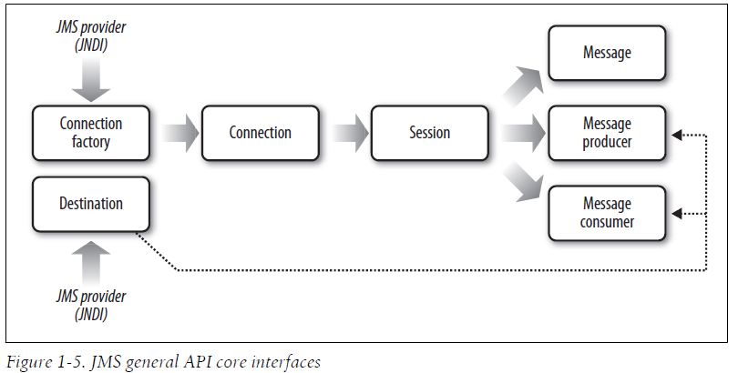

Slide 10
JMS Programming model

Slide 11
JMS API are used
Create Message
Load the business data
Assign network routing info.
Send / Receive message

Slide 12
Queue
Asynchronous Messages
CorrelationID
Fire-and-forgot
Multiple receiver to load balance
QueueBrowser
Request and reply

Slide 13
Filtering
Message Header,
Message Properties only used
MessageSelector
QueueReceiver
SQL-92 expression used.
QueueBrowser
TopicSubscriber
When Message Produce have full control to which destination has to be directed and has enough knowledge how who & how will consumed , ok for Tight coupling
Identifier
Multiple-Destination approach
Literal
Comparison expression
Message Filter approach

Slide 14
ACK Mode
Auto_Acknowledge
client_Acknowledge
Dup_ok_Acknowledge

Slide 15
Every JEE container must implements JMS API (JMS Provider ) internally.
.
But some time we use external JMS provider even though our JEE container have internal JMS Provider
MDB only can do Asynchronously consume/produce message
Servlet, SessionBean can be Synchronous message Consumer / Producer.
It cannot do by Asynchronously.
Since these are executed / called /driven by Request based (HTTP / RMI-IIOP )

Slide 16
JMS with EJB
The different module integration of same application can use QUEUE, this is done in citco project
JMS with Spring
JMS with pojo

Slide 17
JMS with Spring
Use of JMSTemplate for Synchronous
Use of MessageListerner Container for Asynchronous

Slide 18
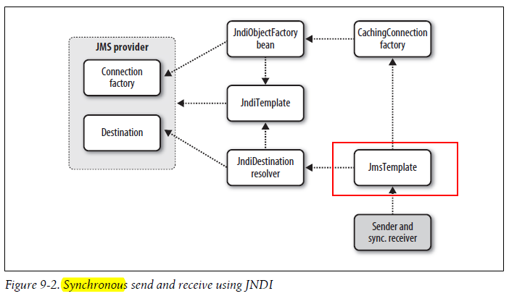

Slide 19
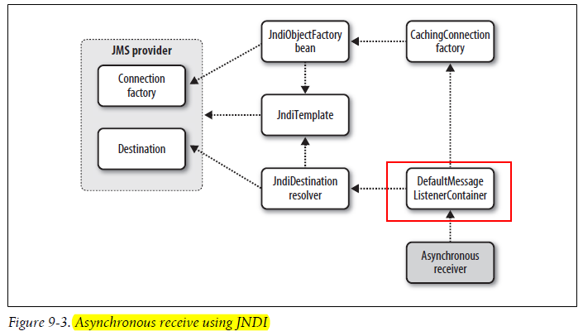

Slide 20
QueueRequestor

